Slide 1
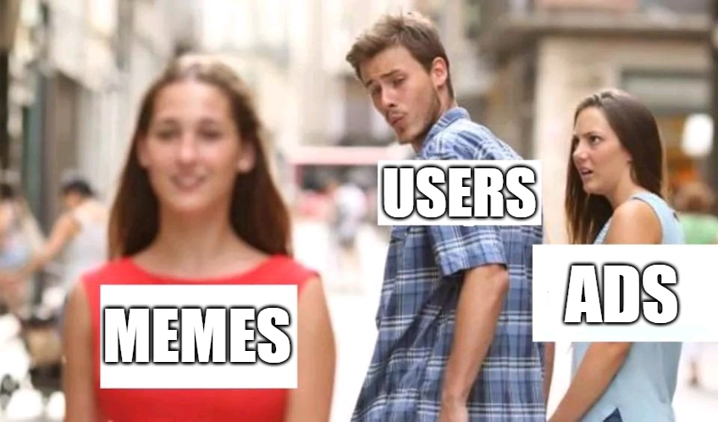
MemeReplace
Introduction to Interaction Design (IXD 5106)
Presented by, Samson Maveli Mathews

Slide 2
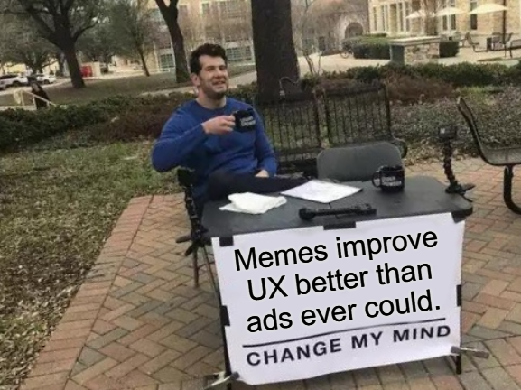
What we do
We replace annoying ads with memes.
The plugin/extension gives you context-aware memes.

Slide 3
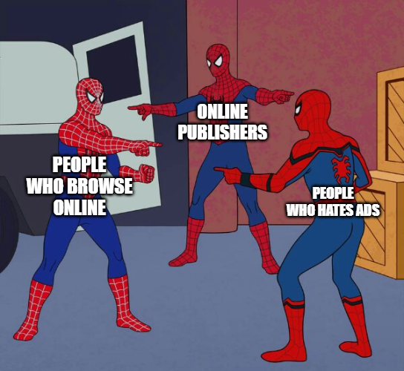
Who we serve

Slide 4
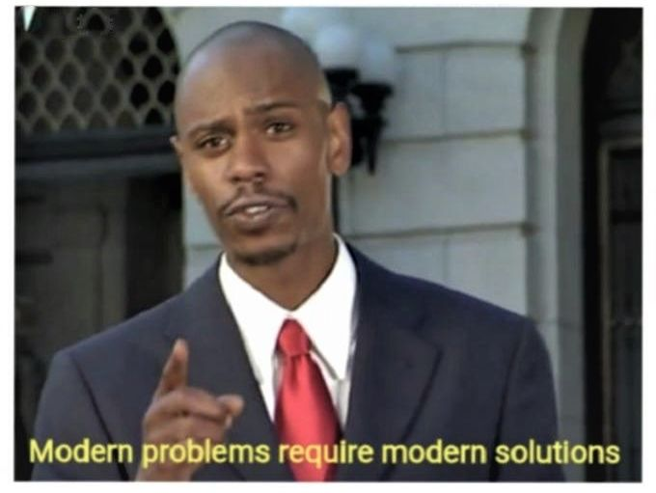
The problems we solve
Ads ruining user’s interest in the website
The bounce rates from websites
Low DAUs [Daily Active users]

Slide 5

The Script
Most 'people who browse online' struggle with watching ads.
The reason is because they feel forced and doesn't like too many ads while browsing a webpage.
When this happens, people becomes disinterested.
Until all of a sudden, people quit the webpage.
What I do is I specialize in 'replacing ads with memes' to make them tolerable.
The reason why I recommend 'MemeReplace' is because it's the single most effective way to stop ads from ruining peoples' lives.
And the benefit of replacing generic ads is to increase the user retention.
All of which allow you to make users spend more time online without worrying about watching ads.

Slide 6
THANK YOU
Questions?

